Slide 1
Introducing Access®
Cardholder Training
Washburn University
February 2017

Slide 2
Access Online Lessons
Online Registration
Forgot Your Password
Logging In
Navigation Basics
My Personal Information
Account Profile
Viewing Statements
Transaction Management
Allocate Transactions
Upload Receipts
Manage Approvals

Slide 3
Online Registration

Slide 4
Online Registration

Slide 5
Online Registration

Slide 6
Logging In
Organization Short Name
User ID
Password

Slide 7
Forgot Your Password
Forgot your password?

Slide 8
Navigation Basics
Check you Client Home page often for messages in the Message Center.
Chris Smith
Change your language.
Home
Contact Us
Training Links
...1243 Chris Smith
You may be able to review a quick summary of your current account information (billing cycle close date, payment due date, balance, credit limit, and recent transactions).
You may be able to use quick links to go to common tasks.

Slide 9
My Personal Information
Change your password
Contact Information
Account Access
Add an Account

Slide 10
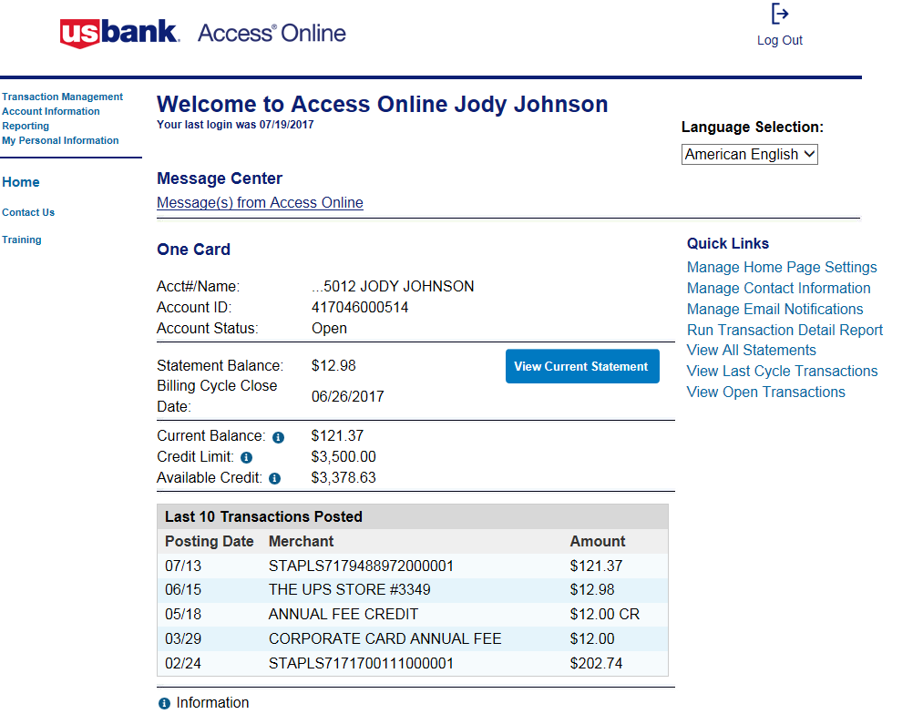
Chris Smith
f
…1234, CHRIS SMITH

Slide 11
Account Profile
1234, JOE H SMITH
Demographic Information
Authorization Limits
Financial History
Account Information

Slide 12
Viewing Statements
1234, JOE H SMITH
Cardholder Statements

Slide 13
Viewing Transactions
Chris Smith
Quick lick to transaction management function
…1234 CHRIS SMITH
Quick links to transactions

Slide 14
Viewing Transactions

Slide 15
Transaction List
1234, CHIRS SMITH
Card Account Summary
…1234
CHIRS SMITH
Search Criteria
Links to Transaction Details
Transaction List

Slide 16
Transaction List

Slide 17
Attach a PDF to a Transaction
Select the Transaction Management link.
Click the Transaction List link.
On the lists of transactions, click the Paperclip icon.
Click the Browse button.
Search and select the PDF file to attach.
Click Open.
Click Attach.
Click the PDF icon to open and view the attached PDF file

Slide 18
Reallocate a Transaction
…1234
CHRIS SMITH
Cardholders will enter the FOPAL coding for each transaction. Washburn will not have default account coding.

Slide 19
Reallocate a Transaction
The Amount Remaining must be zero

Slide 20
Reallocate a Transaction
Office Supplies
000000
000000
000000
00000

Slide 21
Transaction Approval

Slide 22
Transaction Approval

