Slide 1
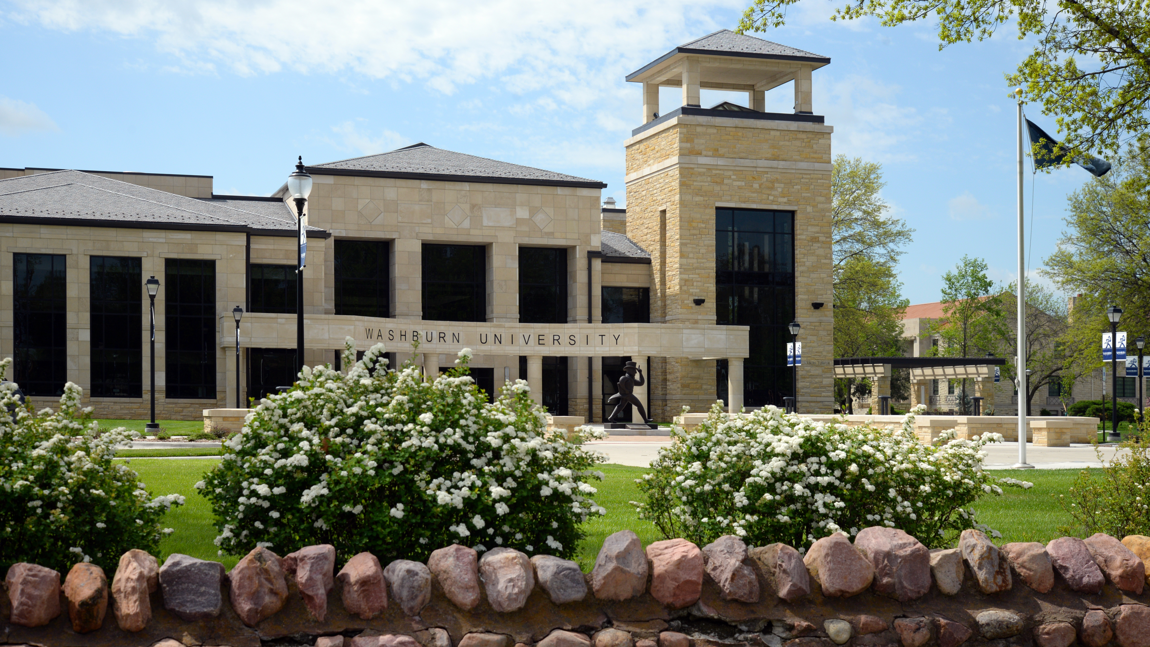


BODstander

Slide 2
Becoming a ‘Bodstander’
Notes:
Facilitators introduce themselves
Ground Rules:
Privacy – Sharing is not required, but should individuals share with the group today, the information disclosed should not leave the room
Respect – We are actively choosing to listen to each other today. It’s important that we speak and respond in respectful ways.
No one will be forced to engage, it’s okay to pass
Take care of yourself – The information being covered today can be difficult. Please feel free to do what you need to do to be okay. Today’s discussion is all about how we look out for each other, so if you choose to step out, one of us will check on you. You don’t have to engage with us if you don’t want to, but we’ll do our part to make sure you have the chance to talk if you need to.

Slide 3
‘BODstander’ Basics:
What is a bystander?
Are our perceptions of bystanders positive or negative?
Notes:
Facilitator 1 Lead discussion about the questions
Facilitator 2 write responses on white board.

Slide 4
Bodstanders, Defined
Bystanders are individuals who witness emergencies, criminal events or situations that could lead to criminal events and by their presence may have the opportunity to provide assistance, do nothing, or contribute to the negative behavior.
Prosocial bystanders in the context of this program, are individuals whose behaviors intervene in ways that impact the outcome positively.
At Washburn, we refer to prosocial bystanders as BODStanders.
Notes:
Facilitator 1 Read the definitions aloud Point out the comparisons and emphasize the strengths and existing knowledge by pointing out how much of the definition the group had already touched on.
Explain the goal of the program is to encourage people to become active, prosocial bystanders – or BODstanders.
Facilitator 2 circle the shared components of the participant’s discussion from previous slide and the definitions being presented.

Slide 5
Bystander Intervention is helpful in many situations including:
Racism
Homophobia
Violent or dangerous behavior
Domestic Violence
Sexual Violence
Mental health concerns or emergencies
Physical health concerns or emergencies
Notes:
While this BODstander training may focus heavily on sexual violence prevention, it is important to note that bystander intervention strategies can be used in many situations including the following discrimination and emergencies.

Slide 6
Prevention Efforts at Washburn
BODstander training is one example of prevention efforts that focus on the whole community and how we, together, can reduce the rates of campus sexual assault.
Our goal is to give everyone the tools to recognize and intervene in situations that .could be damaging or dangerous.
Notes:
Facilitator 2 Washburn is continuing to work to build and maintain a culture of consent and safety on campus. You’re invited to be part of that change by learning skills to intervene in a difficult or potentially dangerous situation. Today, we'll focus on learning to recognize instances sexual violence in all kinds of situations and identify opportunities to intervene. It’s important to remember these skills can easily be used to step-in when witnessing other kinds of harassment and interpersonal violence as well.
Throughout the year you’ll see many examples of this topic being discussed at Washburn in efforts to involve the whole WU community in culture change. Examples might include skill shops, coffee talks, art installations, Safe Colleges online training, poetry readings, etc.

Slide 7
Emily’s Story
Notes:
Facilitator 1:
As we recount the key events in Emily’s story, we’ll be working together to identify who the bystanders were and what opportunities were missed to intervene. Each time you recognize a place in the story where a bystander can intervene, please shout out “here!”, describe who the bystanders were and what they could have done.
Read Aloud:
Emily is having dinner with her family. She has already graduated and is working full time. Her sister is a college student and is visiting from out of town. Emily’s sister is going to a party with friends later. At first, Emily plans to stay home but her sister is leaving early the next day, so Emily decides to go out after all because she wants to spend more time with her sister. Emily and her sister drive to the party together, which is about 10 minutes away from their house.
At the party, Emily drinks more than normal. Her tolerance for alcohol was is lower than it used to be – meaning she feels the effects of the alcohol harder and faster than she expected to. ***Prompt class to explore ways bystanders could have intervened here. Potential bystanders at this point in the story include sister and friends who she was drinking with and may have recognized she was getting drunk.
Later, Emily gets separated from her sister.
Emily calls her boyfriend and leaves a voicemail. Her speech on that message is obviously slurred and distorted. He can tell she’d been drinking. At first, he doesn't worry because everyone knows Emily is at the party, where the party is, and who she's with.
Emily is dancing at the party. Her sister is looking for her in the crowd but cant find her. A guy at the party Emily doesn't know begins to dance with her. Then he takes her outside. Remember, Emily is already drunk. So drunk, in fact, that her intoxication was recognizable in the short voicemail she's just left her boyfriend. ***Prompt class to explore ways bystanders could have intervened here. Potential bystanders at this point include anyone who noticed Emily at the party and could see she was drunk. Also, everyone who saw the guy take her outside. Seeing someone who is drunk intentionally being led away by someone else is a red flag, an opportunity to check in.
Once they are outside, the guy starts to undress her. He takes off her sweater and her underwear. While she lays there unconscious, he rapes her on the ground behind the fraternity dumpster while the party continues just inside.
Two men happen to come by the fraternity on bikes and they see the man on top of her. She appears to be unconscious and he appears to be having sex with her. The men come to her defense, riding their bikes to where the attack is taking place. The guy who is raping Emily flees on foot, but the men catch him and hold him while they call for the police. *** Discuss these bystanders and how they intervened.

Slide 8
Emily’s Story,
Exploring Missed Interventions
Bystander | Observation | Intervention
Friends / Sister | Emily was becoming very drunk | Help Emily get home
Other people at party | Emily was separated from her friends | Help Emily find the people she came with
People who saw her led outside | Emily was very drunk, cannot consent to whatever is about to happen | Create a distraction, pretend to know Emily, etc.
Men on bicycles | Emily is being assaulted | Stop assault and call police
Notes:
Facilitator 1
Let’s talk a bit about why we don’t intervene sooner. To start, I’d like you to give us some examples of things you’ve seen, heard, experienced, or even just heard about or observed in media.
Often, the acts which are easy to identify as harassment or violence are the things we see the least often. And the things we see all the time can be hardest to recognize as contributing to violence.
What are some reasons we don’t intervene earlier on? (Examples might include being unsure, being worried about repercussions, having less power than the person engaging in the behavior, etc.)
It can be tempting to focus on the men who rescued Chanel during the actual rape. Often, when we imagine what it would mean for us to be a bystander, we imagine scenes like this – where the danger is obvious and a daring rescue is necessary.
It’s important, though, to remember that we identified many people and opportunities much earlier in the evening where this assault could have been prevented. The goal of this training is to empower you to see the red flags sooner and to feel more confident in acting then. By the time it’s obvious and the needed interventions are heroic, someone is already being hurt.
It’s also important to point out that having missed an opportunity to be a proactive bystander does not mean any of these people are to blame for Chanel's assault.

Slide 9

Emily Doe is Chanel Miller
Notes:
Facilitator 2
Before we move on, here is some additional information about Emily.
You may already be aware of this case. The Emily in our story was known throughout the trial as Emily Doe. Her true name was protected from the time of the rape in Januatry of 2018. Chanel Miller revealed her name and release a book detailing her experiences on September 4th of 2019. Her attacker’s name is Brock Turner. Chanel's case is infamous because of the public spotlight given on Brock’s personal accomplishments during his trial for a violent crome.
In fact, it’s often still referred to as the Stanford Swimmer Case in reference to the public outcry at how much media and even judicial focus was given to Brock’s swim times and identity as a student athlete instead of focusing on how he’d impacted Chanel's life when he raped her.
Despite all of the strengths in Chanel's case – sober eyewitnesses, clear evidence of her intoxication, and Brock’s own admissions, he received no prison time. While he could have been sentenced to up to 14 years in prison, he was sentenced to just 6 months in jail and served only THREE months.
In a public show of support Chanel's victim impact statement, read aloud just before Brock's sentencing, was shared more than 11 million times. The judge, Aaron Persky, was also recalled from the bench by California voters in 2018.
***Be careful not to allow group to get too caught up in the details or their opinions of this case. Also, avoid focusing TOO much on the short sentence as we don’t want to accidentally send the message that survivors shouldn’t report. The purpose of exploring the case today is to identify missed bystander opportunities using a well-known and current example of campus sexual assault.

Slide 10
Factors Affecting Bystander Intervention
Group Size
Ability to Recognize the Situation
Being Directly Asked to Intervene in a Specific Way
Having Seen Prosocial Interventions Role-Modeled
Notes:
Facilitator 1
We know from research and historical examples there are several factors which affect how likely someone is to offer help to someone in trouble.
Group size – weirdly enough, when there are more people around, less help is offered. This can be caused by the diffusion of responsibility (assuming there are others around, so THEY will help) or by social influence (behaving like those around us – thus each one person’s lack of intervention further prevented the intervention of others).
Recognizing the situation – if you didn’t know something could go wrong, why would you intervene? Our challenge to you is to be observant and think critically about what you see going on around you.
Asking for help directly - If you need help for yourself or assistance as a bystander, be direct and specific.
Role-Modeling – We’re going to do some BODStander exercises in a few minutes. Also, the more you engage in effective BODStander behavior, the more people will have seen and observed, thus strengthening their own BODStander skills and strengthening our community!

Slide 11
Deciding to Intervene
Least safe
Close up
Alone
With others
Distant
Safest
Notes:
Facilitator 2
Factors to consider when choosing to intervene include how close or distant you are from a situation as well as whether you’re alone or with others. In general, intervening directly with no one around is the least safe means of intervention while indirect intervention with lots of people around is typically the safest.
Key points to remember:
What feels safe to one person may not feel safe to another.
Likewise, what might feel safe in one situation could feel very unsafe in another.
It’s expected that how each of you might intervene in a given situation might be different from each other and also different across situations.

Slide 12
BODstander Toolbox
Be a friend
Use Humor
Interrupt
Distract
Delegate / Enlist Others
Speak for yourself / be direct
Refer to authority
Use Empathy
Start a Conversation
Notes:
Facilitator 1 and 2 take turns giving examples of each tool. Ask the class for examples as well
Here’s a list of ways you could consider intervening in different situations, and we’ll leave these up for you to see during the practice scenarios we’re about to hand out. What questions do you have about these tools or how to use them?
*** Divide the group into small groups. Hand out the scenarios & allow time to practice. Allow 3-4 minutes of discussion per scenario, then discuss as a group for 3-4 minutes.
***Leave this list up while facilitating practice scenarios.

Slide 13
Practice Scenario:
You have noticed your friend has become more withdrawn and has stopped attending class. You have asked them to hang out and go eat together in the dining hall, but they have started to turn down your invitations. You believe your friend may be feeling depressed or anxious.
What were your intervention options?
What did you decide to do to intervene?
What factored into your decision-making process?
Notes:
Complete this mental health practice scenario as a class before splitting up into groups for following small group scenarios.
We know that wellness and mental health is a huge concern with College students today. Nearly 40% of college students experience depression, according to a 2020 study, 34% of students report experiencing anxiety, and 13% saying they had thought seriously about suicide in the last year.
Today we focused on learning to use BODStander skills to prevent sexual violence and support people who’ve experienced sexual violence. These skills can also be used to intervene during incidents of other kinds of bias or discrimination as well. You can even use these same skills to check in with peers about their emotional wellbeing, provide support, and assist peers in getting help.
When completed go back to previous ‘bodstander toolbox’ slide for students to reference during scenario exercise.

Slide 14
Additional Resources:
Campus Advocate – Molly Steffes-Herman
785-670-3100 option 1
Washburn CAPS – Counseling, Advocacy & Prevention Services
785-670-3100 option 1
24/7 Counseling by phone available by selecting option 2
Psychological Services Clinic
785-670-1750
Student Health Services
785-670-1470
National Sexual Assault Hotline
800.656.HOPE (4673)
National Suicide Prevention Lifeline
Call or text 988
Notes:
Facilitator 1
On this last slide you’ll find various resources available to you on campus as well as the National Sexual Assault Hotline. Just as a reminder, this hotline is equally helpful to people trying to be a good support or process how they could have helped differently as well as being available to people who’ve experienced sexual assault themselves.
If you have any questions or comments about the presentation, please feel free to ask now while you’re completing the feedback sheets.
*** Handout feedback sheets.

