Slide 1
The Psychology of Prejudice
PY 311
Notes:
Open ended exam question: describe the three approaches to understanding prejudice that were outlined by Gordon Allport.

Slide 2
Q&A #6
In your opinion:
  Where does prejudice come from?
  What are the root causes of prejudice?

Slide 3
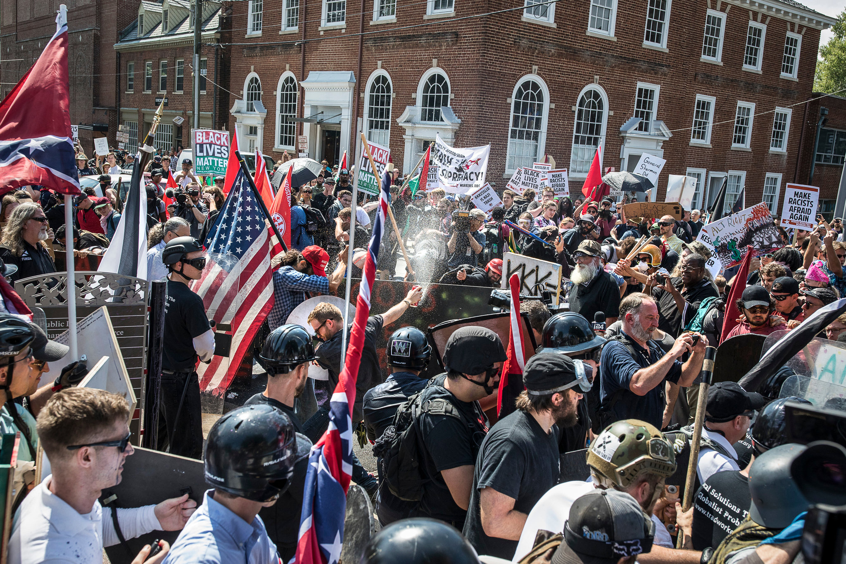
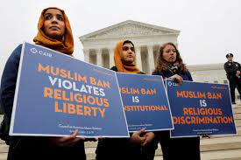
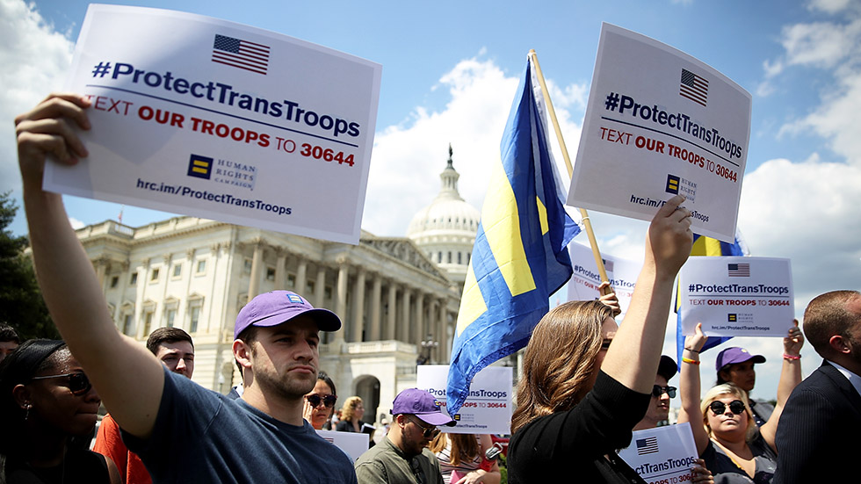
What is Prejudice
We see examples of Prejudice all the time
  Travel Bans
  Transgender military personnel
  Charlottesville rioting
Prejudice exists in all cultures
  Aronson (2018)
    May be an evolutionary benefit of making people wary of strangers

Slide 4
What is Prejudice
Prejudice is made up of several components:
  Cognitive Components
  Emotional Components
  Behavioral Components

Slide 5
The Cognitive Component of Prejudice: Stereotypes
Categorization → grouping of objects or people by key characteristics
  Fundamental category for social animals is “us” or “them”
  Begins in infancy
    Early on we categorize by visual information
    Gender, age, race, etc.
  Other categories are learned later
    Ethnicity, sexual orientation, religion

Slide 6
The Cognitive Component of Prejudice: Stereotypes
Stereotype → generalizations of groups and/or members based on categorization
  Belief that certain attributes are common to every member of a given group

Slide 7

The Cognitive Component of Prejudice: Stereotypes
Dark side of stereotypes
  Distort Reality
  Justify Discrimination
  Create Conflict
  Inflame prejudices

Slide 8
Stereotypes, Sexism, and Gender
Gender stereotypes exaggerate differences between groups
  Tend to ignore differences within groups
Glick and Fiske
  Hostile Sexists: hold negative stereotypes of women
  Benevolent Sexists: hold positive stereotypes of women

Slide 9
Announcements & Reminders (3/5)
Learning Excursion #2
  Due March 22nd by 11:59pm
Exam 2 → March 28th
Notes:
Previously we talked about the cognitive component of prejudice (i.e., stereotypes)

Slide 10
The Emotional Component of Prejudice: Gut Feelings & Hatreds
All humans have some degree of prejudice
  Learned from our environments
Prejudice can be emotional
  Resistant to rational arguments
Deeply prejudiced individuals are virtually immune to messages that counter their beliefs

Slide 11
The Emotional Component of Prejudice: Gut Feelings & Hatreds
Phelps et al. (2000)
  White participants were shown faces of unfamiliar Black males and unfamiliar White males
  Elevated amygdala activity for participants who saw outgroup members
  Almost no amygdala activity when looking at ingroup members

Slide 12
The Emotional Component of Prejudice: Gut Feelings & Hatreds
All humans have some degree of prejudice
  Learned from our environments
Our first thought about another group represents what we have been taught.
Our second thought represents who we choose to be.

Slide 13
The Behavioral Component of Prejudice: Discrimination
Discrimination → negative/unfair behaviors targeted toward a specific group
Racial & Ethnic discrimination
  Has improved over time, but is still pervasive throughout the US (particularly in law enforcement)
    About 14% of the US population is Black
    About 40% of the US male prison population is Black
      30% is Hispanic

Slide 14
The Behavioral Component of Prejudice: Discrimination
Race is still an issue in hiring
  Lavergne & Mullainathan (2004)
    Identical resumes were mailed to companies around the country
    The ethnicity of the applicants’ name was manipulated
      Traditionally “White Sounding” names → Greg and Emily
      Traditionally “Black Sounding” names → Lakisha and Jamal
    What do you think they found?

Slide 15
The Behavioral Component of Prejudice: Discrimination
Race is still an issue in hiring
  Pager (2003)
    Identical resumes were mailed to companies around the country
    Race and criminal record were manipulated
      Black and White males with no criminal record
      Black and White males with a criminal record

Slide 16
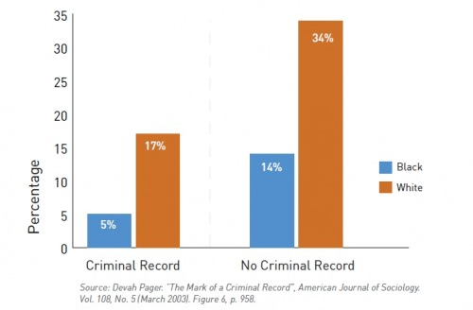
Pager (2003)

Slide 17
The Behavioral Component of Prejudice: Discrimination
Gender Discrimination
  Gender pay gap still exists despite 1963 Equal Pay Act
  Women earn about $.77 for every dollar earned by men

Slide 18
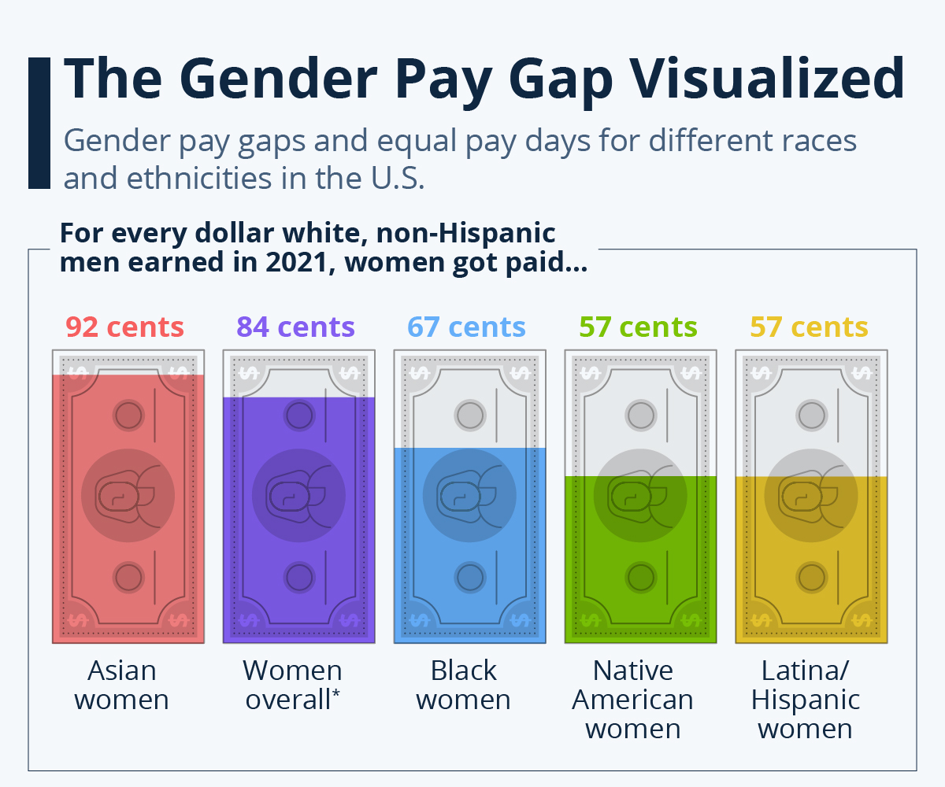

Slide 19
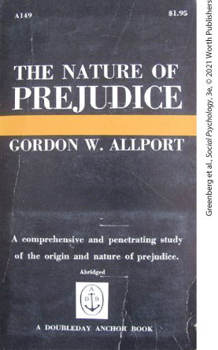
Understanding Prejudice
Gordon Allport (1954)
  Proposed three basic causes for prejudice with very unfortunate consequences
Notes:
Gordon Allport’s (1954) book The Nature of Prejudice launched more than six decades of research on the subject.

Slide 20
Roots of Prejudice: Three Basic Causes
Familiarity-based preferences for the in-group over out-groups
  In-group bias; in-group favoritism
Hostile feelings linked to a specific category (e.g., group) of people
Internalized worldview (i.e., personality)

Slide 21
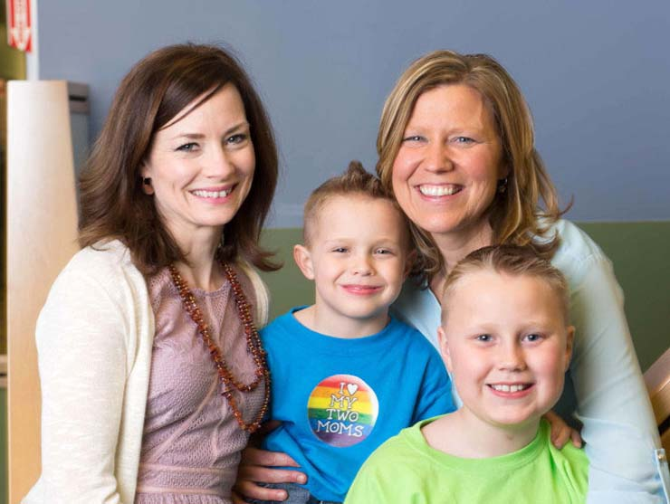

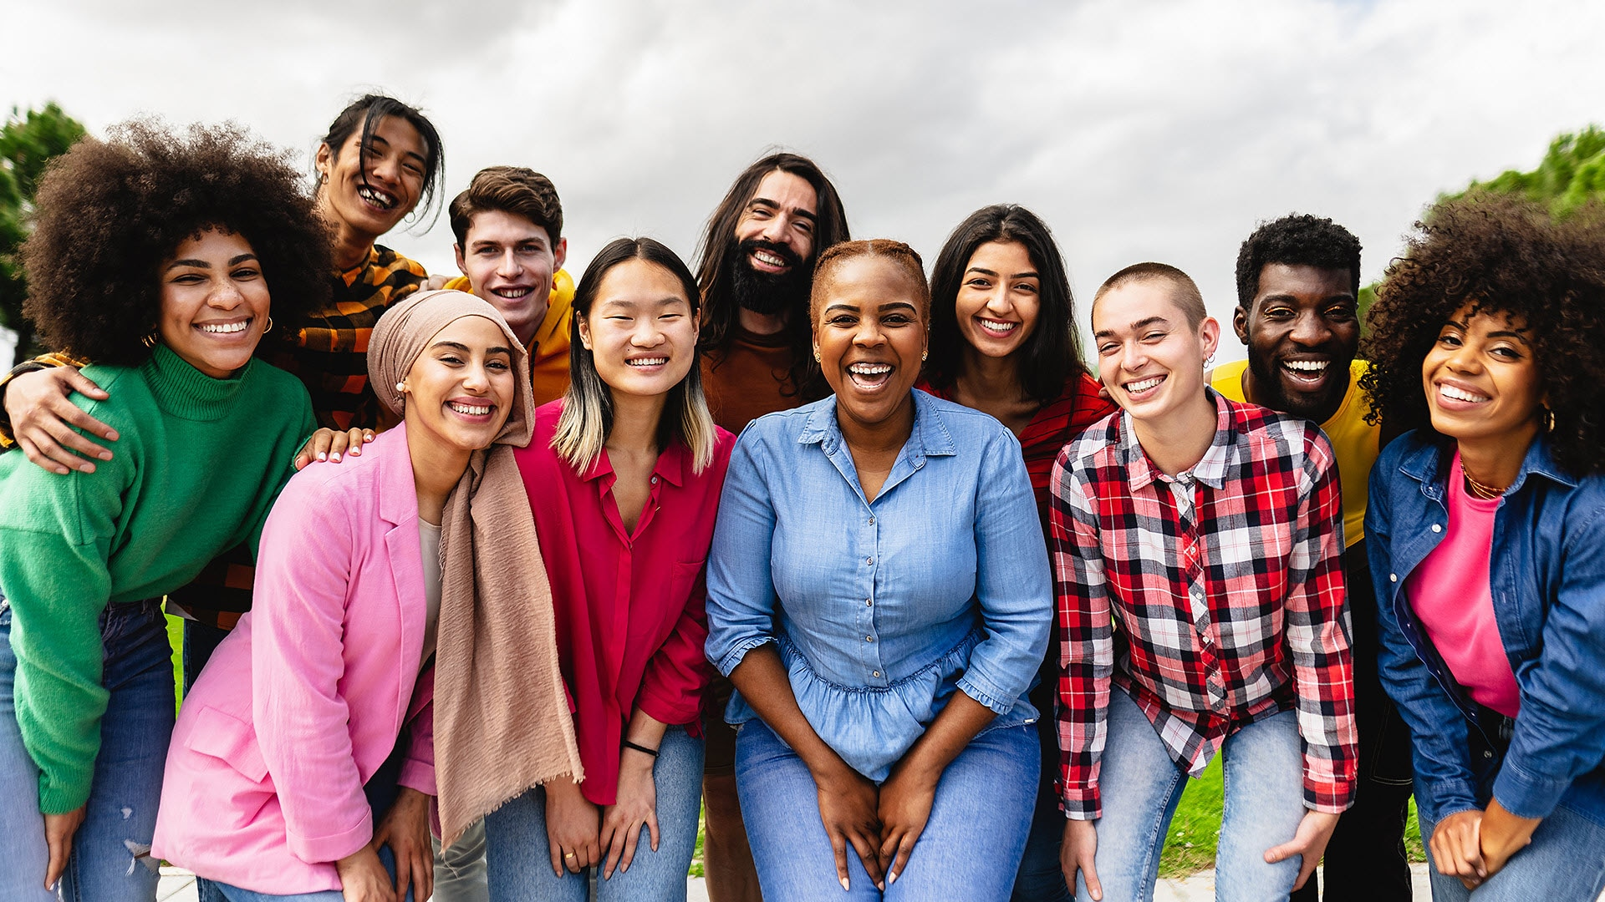
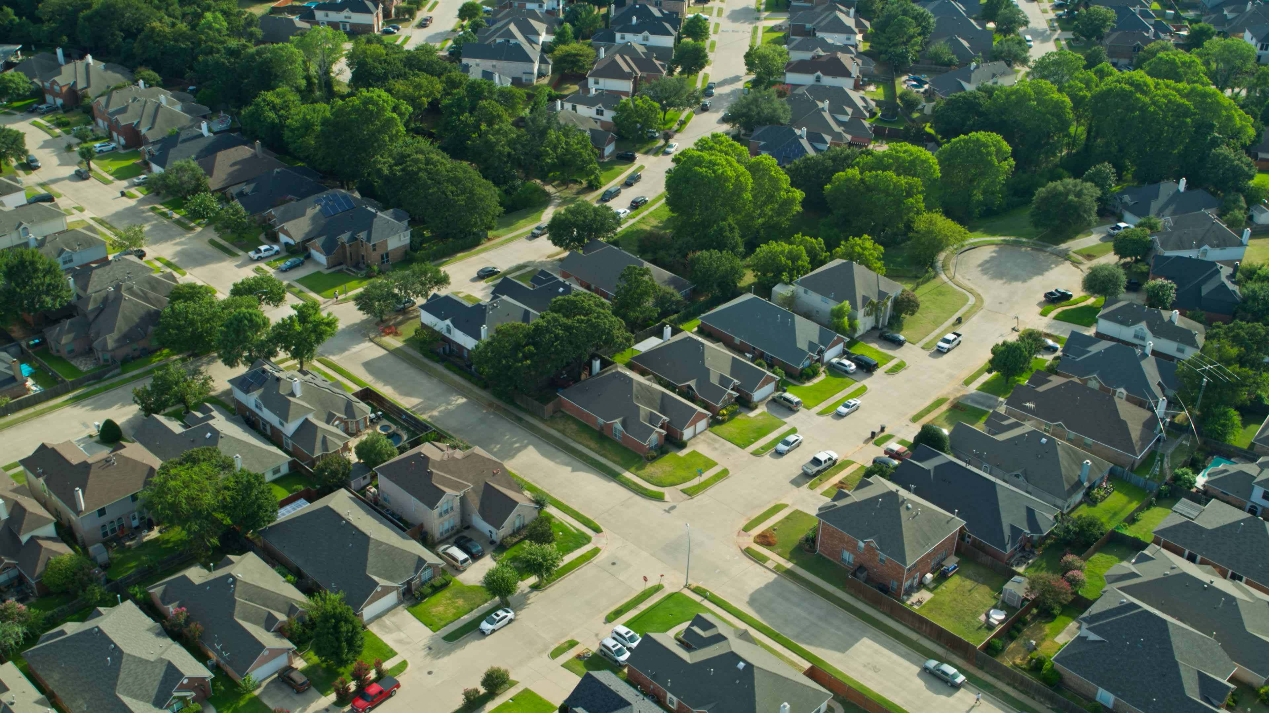
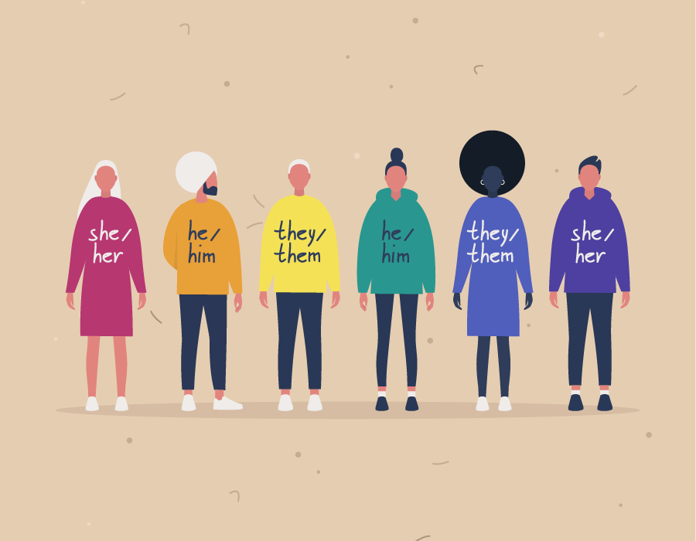
Groups
Humans have always existed in groups
  Family
  Neighborhood
  Community
  Racial
  Ethnic
  Gender
Notes:
Name some groups you are part of. . . . . .
Are those groups important to you?
Why? Or Why not?
Seeing the world in groups –
Humans have always existed in groups, starting from birth – family, neighborhood and community, racial and ethnic groups – Larger system level groups in which they belong
Brewer & Caporeal, 2006; Efferson, LaLive, & Fehr, 2008: Existing and seeing the world in terms of groups in which we belong is profoundly adaptive.
- Meets diverse set of needs
- Family, Kin, community provide care, protection, foster’s survival (Taylor, 2012)
-Enhance capacity to thrive by providing social and material support, as well as opportunities to collaborate and coexist with others who share similar goals, values, language, history, geography, and culture
- Fulfill important psychological emotional, and relational needs.
Baumeister & Leary, 1995; Maslow, 1943): Humans are naturally social, with an innate need to belong and feel accepted by others.
Those that feel accepted (Haslam, Haslam, Jetten, Bevins, Ravenscoft, & Tonks, 2010: Leary, Tambor, Terdal, & Downs, 1995) report higher levels of satisfaction, well-being, and self-esteem.
Those that feel rejected, ostracized, have higher rates of depression, loss of meaning, and suicide (Crewys, Haslam, Dingle, Haslam, & Jetten, 2014; Stillman, Baumeister, Lambert, Crescioni, DeWall, & Fincham, 2009; Van Orden & Joiner, 2013)
Social Identity Theory (Haslam, Ellemers, Reichr, Reynolds, & Schmitt, 2010; Tajfel & Turner, 1979), people derive self-esteem in part from membership in social groups. Our self-concept is compromised of both an individual identity (which reflects our personality, beliefs, preferences, and personal experiences ). Because groups inform our self-concept, we are motivated to value and protect our groups. In turn, our groups successes and failures can affect the way in which we view ourselves

Slide 22
Groups
Adaptive (Brewer & Caporeal, 2006; Efferson, LaLive, & Fehr, 2008; Taylor, 2012)
  Group membership allows for us to meet our basic needs
    Physical needs → protection
    Psychological needs → emotional, relational, social
***Adaptive DOES NOT = Justification for prejudice***
Notes:
Seeing the world in groups –
Humans have always existed in groups, starting from birth – family, neighborhood and community, racial and ethnic groups – Larger system level groups in which they belong
Brewer & Caporeal, 2006; Efferson, LaLive, & Fehr, 2008: Existing and seeing the world in terms of groups in which we belong is profoundly adaptive.
- Meets diverse set of needs
- Family, Kin, community provide care, protection, foster’s survival (Taylor, 2012)
-Enhance capacity to thrive by providing social and material support, as well as opportunities to collaborate and coexist with others who share similar goals, values, language, history, geography, and culture
- Fulfill important psychological emotional, and relational needs.
Baumeister & Leary, 1995; Maslow, 1943): Humans are naturally social, with an innate need to belong and feel accepted by others.
Those that feel accepted (Haslam, Haslam, Jetten, Bevins, Ravenscoft, & Tonks, 2010: Leary, Tambor, Terdal, & Downs, 1995) report higher levels of satisfaction, well-being, and self-esteem.
Those that feel rejected, ostracized, have higher rates of depression, loss of meaning, and suicide (Crewys, Haslam, Dingle, Haslam, & Jetten, 2014; Stillman, Baumeister, Lambert, Crescioni, DeWall, & Fincham, 2009; Van Orden & Joiner, 2013)
Social Identity Theory (Haslam, Ellemers, Reichr, Reynolds, & Schmitt, 2010; Tajfel & Turner, 1979), people derive self-esteem in part from membership in social groups. Our self-concept is compromised of both an individual identity (which reflects our personality, beliefs, preferences, and personal experiences ). Because groups inform our self-concept, we are motivated to value and protect our groups. In turn, our groups successes and failures can affect the way in which we view ourselves

Slide 23
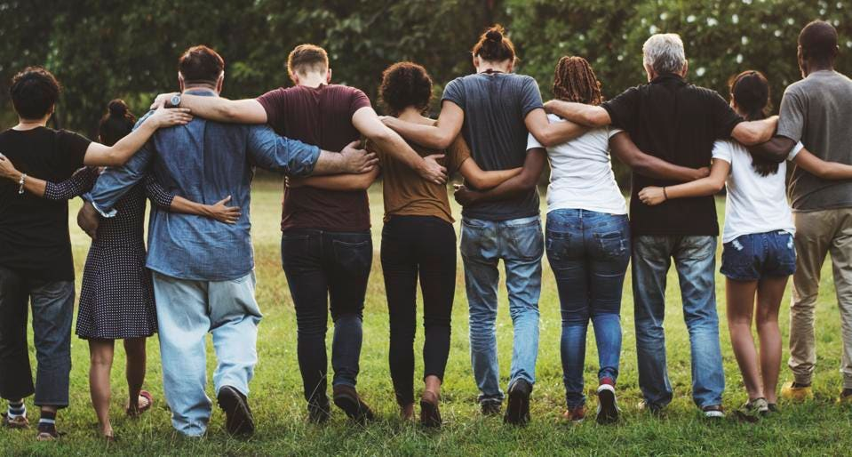
Groups
Humans are naturally social
We have an innate need to belong and feel accepted by others (Baumeister & Leary 1995; Maslow, 1943)
Notes:
Baumeister & Leary, 1995; Maslow, 1943): Humans are naturally social, with an innate need to belong and feel accepted by others.
Those that feel accepted (Haslam, Haslam, Jetten, Bevins, Ravenscoft, & Tonks, 2010: Leary, Tambor, Terdal, & Downs, 1995) report higher levels of satisfaction, well-being, and self-esteem.
Those that feel rejected, ostracized, have higher rates of depression, loss of meaning, and suicide (Crewys, Haslam, Dingle, Haslam, & Jetten, 2014; Stillman, Baumeister, Lambert, Crescioni, DeWall, & Fincham, 2009; Van Orden & Joiner, 2013)
Social Identity Theory (Haslam, Ellemers, Reichr, Reynolds, & Schmitt, 2010; Tajfel & Turner, 1979), people derive self-esteem in part from membership in social groups. Our self-concept is compromised of both an individual identity (which reflects our personality, beliefs, preferences, and personal experiences ). Because groups inform our self-concept, we are motivated to value and protect our groups. In turn, our groups successes and failures can affect the way in which we view ourselves

Slide 24
Groups
Feeling Accepted
  Associated with higher physical & mental well-being
    (Haslam et al., 2012; Leary et al., 1995)
Feeling Rejected or Ostracized associated with:
  Higher rates of depression
  Loss of meaning
  Increased risk of suicide
    (Crews et al., 2014; Stillman et al., 2009; Van Orden & Joiner, 2013)
Notes:
Baumeister & Leary, 1995; Maslow, 1943): Humans are naturally social, with an innate need to belong and feel accepted by others.
Those that feel accepted (Haslam, Haslam, Jetten, Bevins, Ravenscoft, & Tonks, 2010: Leary, Tambor, Terdal, & Downs, 1995) report higher levels of satisfaction, well-being, and self-esteem.
Those that feel rejected, ostracized, have higher rates of depression, loss of meaning, and suicide (Crewys, Haslam, Dingle, Haslam, & Jetten, 2014; Stillman, Baumeister, Lambert, Crescioni, DeWall, & Fincham, 2009; Van Orden & Joiner, 2013)
Social Identity Theory (Haslam, Ellemers, Reichr, Reynolds, & Schmitt, 2010; Tajfel & Turner, 1979), people derive self-esteem in part from membership in social groups. Our self-concept is compromised of both an individual identity (which reflects our personality, beliefs, preferences, and personal experiences ). Because groups inform our self-concept, we are motivated to value and protect our groups. In turn, our groups successes and failures can affect the way in which we view ourselves

Slide 25
Groups
Social Identity Theory (Haslam et al., 2010; Tajfel & Turner, 1979)
  We derive our self-concept (in part) from group membership
  We are motivated to protect our group
  Our group’s success and failures can impact how we view ourselves

Slide 26
Ingroup vs. Outgroups
Tajfel (1974)
  People tend to identify (self-concept) with groups in which they feel they belong → Ingroup
As opposed to groups in which the do not feel they belong → Outgroup
Notes:
In-group – People tend to identify with groups in which they belong (referred to as in-group) – as opposed to group in which they do not feel they belong (outgroup); Tajfel, 1974. This single act is sufficient to set up a cascade of cognitive, motivational, and behavioral consequences that enable us to prefer our in-group (in-group favoritism).
OFTEN at the expense of our outgroup. The mere categorization of the self into a group, no matter how arbitrary the categorization, is sufficient to motivate people to prioritize their group and enhance it’s standing or value (Tajfel, Billing, Bundy, & Flament, 1974). -- Both consciously and unconsciously (Dasgupta, 2004).
- More inclined to reward members of their in-group than members of their outgroup (Tajfel, 1974) -- even if they don’t know them.
- People can feel better about their ingroup if they can put down or derogate members of their out-groups (out-group derogation).
Stereotypes – stereotyping outgroup as less intelligent or capable than one’s ingroup enables people to feel that their group is superior, which makes them feel proud of their group, and by extension, themselves (Reyna & Zimmerman, 2017).
- stereotypes
-Discrimination
-Racism
Discrimination: Potential employers were sent virtually identical job applications from a Black and White applicant. Applicants that were portrayed as White received more calls for an interview than equally qualified Black applicants (Bertrand & Mullainathan, 2004).

Slide 27
Ingroup vs. Outgroups
“This seemingly simplistic aspect of human nature can set off a CASCADE of cognitive, motivational, emotional, and behavioral consequences that enable us to prefer our ingroup often at the expense of our outgroups.”
In-group Favoritism (Trajfel et al., 1974)
Notes:
In-group – People tend to identify with groups in which they belong (referred to as in-group) – as opposed to group in which they do not feel they belong (outgroup); Tajfel, 1974. This single act is sufficient to set up a cascade of cognitive, motivational, and behavioral consequences that enable us to prefer our in-group (in-group favoritism).
OFTEN at the expense of our outgroup. The mere categorization of the self into a group, no matter how arbitrary the categorization, is sufficient to motivate people to prioritize their group and enhance it’s standing or value (Tajfel, Billing, Bundy, & Flament, 1974). -- Both consciously and unconsciously (Dasgupta, 2004).
- More inclined to reward members of their in-group than members of their outgroup (Tajfel, 1974) -- even if they don’t know them.
- People can feel better about their ingroup if they can put down or derogate members of their out-groups (out-group derogation).
Stereotypes – stereotyping outgroup as less intelligent or capable than one’s ingroup enables people to feel that their group is superior, which makes them feel proud of their group, and by extension, themselves (Reyna & Zimmerman, 2017).
- stereotypes
-Discrimination
-Racism
Discrimination: Potential employers were sent virtually identical job applications from a Black and White applicant. Applicants that were portrayed as White received more calls for an interview than equally qualified Black applicants (Bertrand & Mullainathan, 2004).

Slide 28
Ingroup Favoritism
People are motivated to view their in-group in a positive light
  OFTEN at the expense of the outgroup
Categorization of the self into a group, no matter HOW ARBITRARY is enough to motivate people to prioritize their group
  Both consciously and unconsciously (Dasgupta, 2004)
Notes:
In-group – People tend to identify with groups in which they belong (referred to as in-group) – as opposed to group in which they do not feel they belong (outgroup); Tajfel, 1974. This single act is sufficient to set up a cascade of cognitive, motivational, and behavioral consequences that enable us to prefer our in-group (in-group favoritism).
OFTEN at the expense of our outgroup. The mere categorization of the self into a group, no matter how arbitrary the categorization, is sufficient to motivate people to prioritize their group and enhance it’s standing or value (Tajfel, Billing, Bundy, & Flament, 1974). -- Both consciously and unconsciously (Dasgupta, 2004).
- More inclined to reward members of their in-group than members of their outgroup (Tajfel, 1974) -- even if they don’t know them.
- People can feel better about their ingroup if they can put down or derogate members of their out-groups (out-group derogation).
Stereotypes – stereotyping outgroup as less intelligent or capable than one’s ingroup enables people to feel that their group is superior, which makes them feel proud of their group, and by extension, themselves (Reyna & Zimmerman, 2017).
- stereotypes
-Discrimination
-Racism
Discrimination: Potential employers were sent virtually identical job applications from a Black and White applicant. Applicants that were portrayed as White received more calls for an interview than equally qualified Black applicants (Bertrand & Mullainathan, 2004).

Slide 29
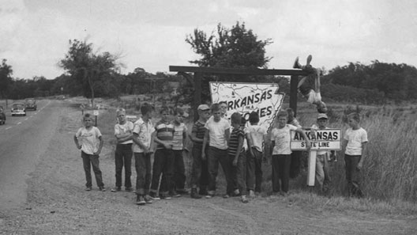
Notes:
The Robbers Cave (Sherif, 1954, 1958, 1961).
Realistic Conflict Theory
Groups in competition for resources
Stereotypes and prejudice rooted in group competition for limited resources
The boys chose names for their groups, The Eagles and The Rattlers, and stenciled them onto shirts and flags.
Sherif now arranged the 'competition stage' where friction between the groups was to occur over the next 4-6 days. In this phase it was intended to bring the two groups into competition with each other in conditions that would create frustration between them.
A series of competitive activities (e.g. baseball, tug-of-war etc.) were arranged with a trophy being awarded on the basis of accumulated team score. There were also individual prizes for the winning group such as a medal and a multi-bladed pocket knife with no consolation prizes being given to the "losers."
The Rattlers' reaction to the informal announcement of a series of contests was absolute confidence in their victory! They spent the day talking about the contests and making improvements on the ball field, which they took over as their own to such an extent that they spoke of putting a "Keep Off" sign there! They ended up putting their Rattler flag on the pitch. At this time, several Rattlers made threatening remarks about what they would do if anybody from The Eagles bothered their flag.
Situations were also devised whereby one group gained at the expense of the other. For example, one group was delayed getting to a picnic and when they arrived the other group had eaten their food.
At first, this prejudice was only verbally expressed, such as taunting or name-calling. As the competition wore on, this expression took a more direct route. The Eagles burned the Rattler's flag. Then the next day, the Rattler's ransacked The Eagle's cabin, overturned beds, and stole private property. The groups became so aggressive with each other that the researchers had to physically separate them.
During the subsequent two-day cooling off period, the boys listed features of the two groups. The boys tended to characterize their own in-group in very favorable terms, and the other out-group in very unfavorable terms.
Keep in mind that the participants in this study were well-adjusted boys, not street gang members. This study clearly shows that conflict between groups can trigger prejudice attitudes and discriminatory behavior. This experiment confirmed Sherif's realistic conflict theory.
Critical Evaluation
The events at Robbers Cave mimicked the kinds of conflict that plague people all over the world. The simplest explanation for this conflict is competition. Assign strangers to groups, throw the groups into competition, stir the pot, and soon there is conflict.
There is a lot of evidence that when people compete for scarce resources (e.g. jobs, land etc.) there is a rise in hostility between groups. For example, in times of high unemployment there may be high levels of racism among white people who believe that black people (or asylum seekers) have taken their jobs. The study was a field experiment which means it has high ecological validity.
However, the Robbers Cave study has been criticized on a number of issues. For example, the two groups of boys in the study were artificial, as was the competition, and did not necessarily reflect real life. For example, middle class boys randomly assigned into two separate groups is not rival inner city gangs, or rival football supporters.
Ethical issues must also be considered. The participants were deceived, as they did not know the true aim of the study. Also, participants were not protected from physical and psychological harm.
Nor should the results be generalized to real life because the research used only 12 year old white middle class boys and excluded, for example, girls and adults. The sample was biased.
APA Style References
Sherif, M. (1954). Experimental study of positive and negative intergroup attitudes between experimentally produced groups: robbers cave study.
Sherif, M. (1958). Superordinate goals in the reduction of intergroup conflict. American journal of Sociology, 349-356.
Sherif, M., Harvey, O. J., White, B. J., Hood, W. R., & Sherif, C. W. (1961). Intergroup conflict and cooperation: The Robbers Cave experiment (Vol. 10). Norman, OK: University Book Exchange.
This Robber's Cave study, just as it is remains, is a very important study that has guided new studies using the principles to reduce measured intergroup conflict in children of different racial or ethic status, wealthy etc. For example, our PeaceBuilders studies, which did have modern IRB's, and did include girls and samples of different ethnic and income groups actually show reductions medically measured violence (conducted by the CDC). That hugely beneficial finding might not have happened had not I read the original study in Grad School, realizing that there was a potentially very useful principle discovered. We also used this principle in the PAX Good Behavior Game studies that have multiple randomized trials to avert or reduce virtually every mental, emotional, and behavior disorder through young adulthood.

Slide 30
Back to Allport
Familiarity-based preferences for the in-group over out-groups
  In-group bias; in-group favoritism
Hostile feelings linked to a specific category (e.g., group) of people
Internalized worldview (i.e., personality)

Slide 31
Hostile Feelings Linked to a Category
Feelings of hostility can arise when one is frustrated, threatened, or witness to unpleasantness or injustice
  9/11
  Covid-19
We routinely categorize people as members of social groups
  Muslims
  Asians
Notes:
This basic cause of prejudice is the result of two basic human tendencies:

Slide 32
Out-Group Hostilities
Realistic Group Conflict Theory (Levine & Campbell, 1972)
  Initial negative feelings between groups are often based on real conflict or competition regarding scarce resources
Negative feelings toward groups are often culturally transmitted through generations
  Can happen even if the original conflict is no longer pertinent

Slide 33
Cultural Worldviews
Ethnocentrism: evaluating other cultures according to the standards and customs of one’s own culture
Ethnocentric biases can lead people to judge other’s cultural preferences as different and inferior
Terror Management Theory
  People need to protect themselves from the fear of living an insignificant life
  Convince themselves that they are part of an important group
  Contributes to the belief that their cultural worldviews are better than others
Notes:
A particular cultural worldview specifies what is right/wrong and good/bad. Ethnocentric biases lead people to judge others’ cultural preferences and beliefs not just as different, but as inferior to their own.
Ethnocentrism
Conforming to the norms and values of one’s worldview can lead to prejudice
Because worldview determines our view of what is right and good, others are often judged on the basis of those cultural values (ethnocentrism).

Slide 34
Back to Allport
Familiarity-based preferences for the in-group over out-groups
  In-group bias; in-group favoritism
Hostile feelings linked to a specific category (e.g., group) of people
Internalized worldview (i.e., personality)

Slide 35
The Prejudiced Personality
Right-Wing Authoritarianism (RWA)
  Ideology that holds that the social world is inherently dangerous
  Maintaining order is vital
    Requires upholding society’s laws and traditions
  RWA predicts prejudicial attitudes against groups perceived as socially deviant or dangerous

Slide 36
The Prejudiced Personality
Right-Wing Authoritarianism (RWA)
  Three common characteristics among those higher in RWA (Altemeyer, 2006)
    Believe in the importance of respecting established authorities
    Have a higher tendency to being aggressive in the name of their authorities
    Have a preference for tradition
*** RWA is more like a personality trait (e.g., outgoing, shy) rather than a description of political views***

Slide 37
The Prejudiced Personality
Social Dominance Orientation (SDO)
  Associated with the belief that the world is a ruthless, competitive jungle
  Appropriate and right for powerful groups to dominate weaker ones
  Need for structured knowledge
    A tendency to think in simple, clear-cut ways

Slide 38
Announcements & Reminders (3/7)
Learning Excursion #2
  Due March 22nd by 11:59pm
Exam 2 → March 28th
Psi-Chi/Psychology Club
  March 18 12-1pm
  HC 112
  Valeo Behavioral Health – Auditory Hallucination Training
Notes:
Previously we talked about the cognitive component of prejudice (i.e., stereotypes)

Slide 39
RWA & SDO (Crawford et al., 2013)
RWA → Seeks stability and not to overthrow
SDO → Seeks to dominate and even overthrow others in order to gain power and control
Both feed into prejudice
  SDO correlates with prejudice against “inferior or disadvantaged groups”
  RWA correlates with prejudice against threatening groups or those who do not conform to tradition
Notes:
SDO correlates to higher prejudice against subordinate and disadvantaged groups, RWA correlates to higher prejudice against groups deemed threatening to traditional norms, while both are associated with increases in prejudice for "dissident" groups.
SDO seeks to dominate or even overthrow those that are in power in order to gain control. On the other hand, RWA seeks stability and not to overthrow. They both feed into prejudice but SDO correlates to prejudice against inferior and disadvantaged groups while RWA correlates to prejudice against threatening groups—or those do not conform to tradition (Crawford et al., 2013).

Slide 40
Back to Allport…
Familiarity-based preferences for the in-group over out-groups
  In-group bias; in-group favoritism
Hostile feelings linked to a specific category (e.g., group) of people
Internalized worldview (i.e., personality)

Slide 41
Old-Fashioned vs. Modern Prejudice
Historically, expressions of prejudice have been overt (i.e., easily recognizable behaviors)
  Racial segregation
  Lynching
Various societal and cultural events have made overt expressions of prejudice (i.e., labeled “Old-Fashioned”) taboo/unacceptable
  Civil Rights Movement
  Brown v. Board of Education

Slide 42
Old-Fashioned vs. Modern Prejudice
We are not a “post-racial” society
Prejudiced beliefs and behaviors have evolved
“Modern” Expressions of Prejudice

Slide 43
Old-Fashioned vs. Modern Prejudice
Aversive Racism Theory (e.g., Dovidio & Gaertner, 2004)
  People are not openly hostile toward certain outgroup members
  People are motivated to avoid certain groups out of feelings of discomfort or fear

Slide 44
Old-Fashioned vs. Modern Prejudice
Modern Racism Theory (e.g., Kinder & Sears, 1981)
  People know that old-fashioned beliefs are inappropriate
    Avoid displaying such behaviors
  People engage in more subtle forms of prejudice
    Express opposition toward progressive policies (e.g., affirmative action)

Slide 45
Old-Fashioned vs. Modern Prejudice
Overall, more modern theories of prejudice highlight the inappropriateness of old-fashioned beliefs
Also try to identify the more covert (i.e., subtle) forms of modern prejudice
People may only behave in a prejudice way if they feel justified to do so

Slide 46
Justification Suppression Model of Prejudice (Crandall & Eshleman, 2003)
This model argues that all humans are prejudiced to some extent
Actual expressions of prejudice depend on:
  Justification factors → express prejudice without guilt/shame
  Suppression factors → expression of prejudice would be inappropriate

Slide 47
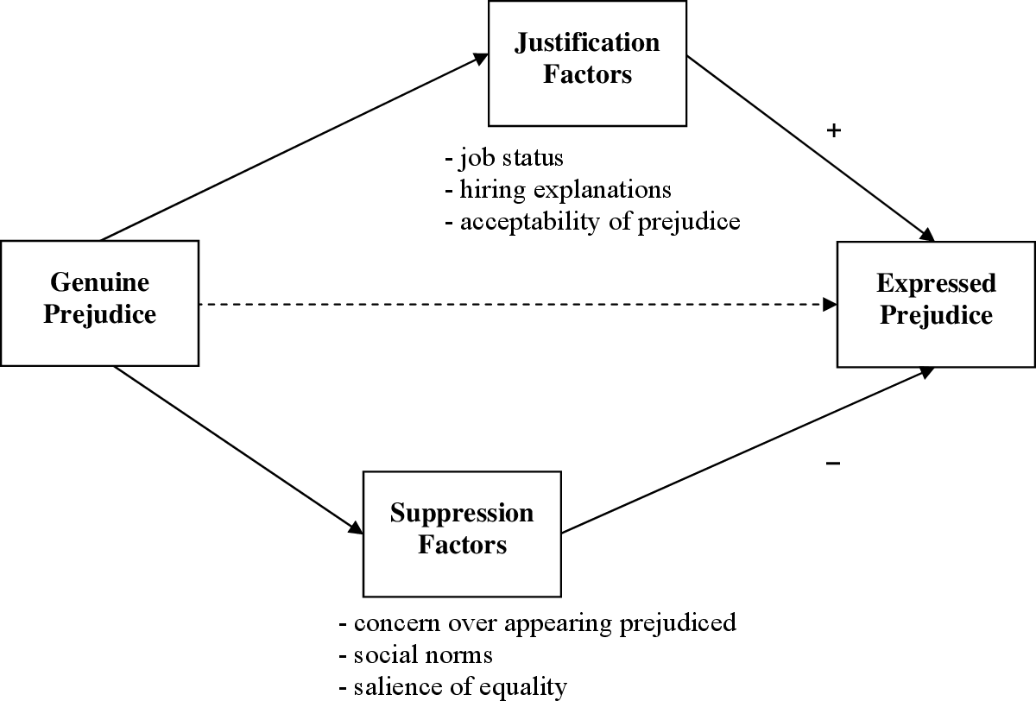

Slide 48
Reducing Prejudice

Slide 49
What is Prejudice?
Negative attitude toward an individual based on that person’s presumed membership in a particular group

Slide 50
What can we do?
We can think about others in terms of their individual qualities (Fiske, 1998, 2000)
Group membership = Arbitrary categories
    E.g., Robbers Cave experiment
  Important identity at a particular time determines who is “in” and who is “out”
Social categorization into groups is fluid (NOT FIXED)
  Decategorization
  Recategorization
Notes:
Although thinking about people in terms of their group membership may be our cognitive default, we can think about others in terms of their individual qualities when we are so motivated (Fiske, 1998, 2000)
We know our friends, romantic partners, teammates, roommates, and other who we want to be close to on an individual basis.
We think about ourselves and others as members of different groups at different times.
Depending on what identity is important or salient to me at a particular time determines who is “in” and who is “out”
Perceptions of social categorization – although fundamental to human perception, cognition and social functioning – is FLUID

Slide 51
Decategorization
Change how people think about themselves and others (e.g., Miller, 2002)
  Group members vs. distinct individuals
Stop thinking in terms of arbitrary groups
  Us & Them → Me & You

Slide 52

Decategorization
Personalization
  Exchange information about each other
  Helps to convey unique personal qualities
  Helps to form friendships
  Recognize that stereotypes are incorrect
    Undermines prejudice toward the whole group, not just the person (Davies et al., 2011)
Notes:
Personalization: When you exchange information about each other in a way that conveys your unique personal qualities, you typically recognize that your stereotypes of the group are incorrect, which undermines your prejudice against the group as a whole.
Personalization is one reason why forming friendships with a member of another group has such a strong effect for reducing bias toward the group (Davies, Tropp, Aron, Pettigrew, & Wright, 2011).
Personalization is most likely to change attitudes toward the group as a whole when the other person who discloses personal information is a typical, rather than atypical, member of a different group.
A typical member of a group represent what most people in the group are like. If what you learn about the person contradicts your stereotype of the group, that experience will challenge your prejudice toward the whole group.
If that person is an atypical member of the group, there is little reason for your experience with this individual to transfer to the group as a whole, because that person is not like other members of the group.

Slide 53
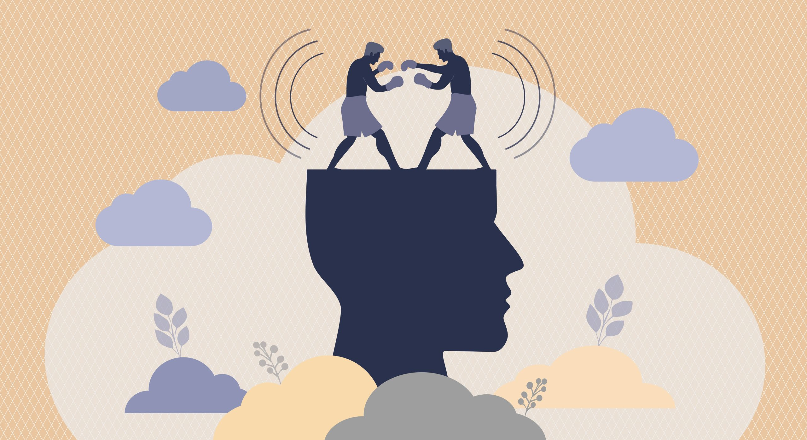
Decategorization
Personalization can create cognitive dissonance
  Liking a member of a certain group is inconsistent with disliking that group
Notes:
Cognitive dissonance is a mental conflict that occurs when your beliefs don't line up with your actions. It's an uncomfortable state of mind when someone has contradictory values, attitudes, or perspectives about the same thing.
Not liking a group and its members is INCONSISTENT with feeling close to a typical member of that group.
Inconsistent = uncomfortable.
We don’t like being uncomfortable
Change your view to be CONSISTENT with your immediate, concrete, and meaningful connection with the outgroup member.
What psychological process is at work when you feel close to a member of another group that you previously did not like? It may arouse cognitive dissonance.
Not liking a group and its member is inconsistent with feeling close to a typical member of that group.
If your view of the group was based on mainly second-hand information, then you would likely change your view to be consistent with your immediate, concrete, and meaningful connection with the out-group member. AS we described in Chapter 3
Once a positive bond is established between members of two different groups, group attitudes change to fall in line.
Although we generally try to simplify the way we think about the world – the reason we use social categorization in the first place – we fundamentally want to see the world accurately.
Learning about what another group is like through a close personal relationship overrides what we think about the group generally and abstractly.

Slide 54
Decategorization
Limitations of Decategorization
  Hard to sustain over time
    Need to categorize undermines the ability to sustain decategorication over time
  Intense/Historical Conflicts
    May not be possible to engage in personal interactions
    May not be motivated to engage
    Stereotypes may prevent individuals from disclosing information
Notes:
One of the problems with recategorization, however, is that categories help us simplify a complicated world.
Decategorization impressions cannot be sustained for long.
Our basic need to categorize people undermines the ability to sustain decategorization representations over time.
In some circumstances, such as intense conflicts or as a result of segregation, we may not have opportunities to engage in these kinds of personalized interactions. In fact, even when we have an opportunity of this type, our group biases and stereotypes may prevent us from disclosing personal information because that could make us feel vulnerable. In these cases, alternative strategies for reducing bias may be useful.
However, they open the door to getting to know someone from a group that you always thought of as being different from you and your group.
Personalization: When you exchange information about each other in a way that conveys your unique personal qualities, you typically recognize that your stereotypes of the group are incorrect, which undermines your prejudice against the group as a whole.
Personalization is one reason why forming friendships with a member of another group has such a strong effect for reducing bias toward the group (Davies, Tropp, Aron, Pettigrew, & Wright, 2011)

Slide 55
Recategorization
Alters group boundaries by redefining rather than eliminating group categorization (Gaertner & Dovidio, 2000)
  Playing on the same “team”
  They → We

Slide 56
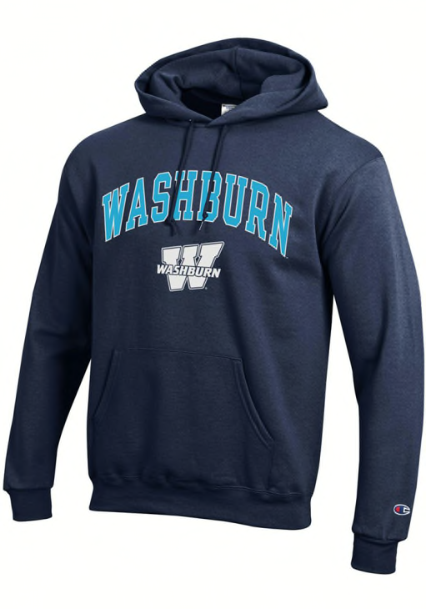
Recategorization
Imagine a person walking down a busy street
  What do you first notice about people?
  What if they are wearing a Washburn hoodie?
    Does this change how you feel about them?
Notes:
Notice people, notice their race, their gender. . . .
Different social identities then you do
HOWEVER, you notice the person is wearing a sweatshirt of your college
Replacing the original categorization of members of different groups with an overriding shared identity.
Imagine a person is walking down a busy street. As people approach you, you automatically notice their race, and you think about them in terms of their racial membership.
HOWEVER, as a person from another race approaches you, you notice that he is wearing a sweatshirt from your college. Will you feel differently about him now? According to recategorization, you will.

Slide 57

Recategorization
Common In-Group Identity Model (Gaertner & Dovidio, 2000)
  Builds upon social identity theory
  Changing Them → We = Ingroup Favoritism benefits
    Happens spontaneously, little thought/effort
Notes:
I’m going to give you a minute to work with a neighbor to recall social identity theory and what it does.
Motivated to protect the group because you are motivated to protect yourself; motivated to favor the group.
It is possible to chance the ways we think about others by changing the way we think about their group membership. Emphasizing a common group membership can change the way we typically think about others from an “us” verses “them” to be more inclusive, superordinate “we” connection. This approach builds upon the principles of social categorization and social identity theory discussed earlier in this chapter.
Once you categorize me as an “in group member (a “we”) rather than an outgroup member (a “they”), I will benefit from all the pro-in group biases that make you like me more, discount my flaws, and want to work with me to promote “our” group.

Slide 58

Recategorization
Nier et al., 2001
  Conducted a study at a Football Game
  Researchers asked individuals if they would complete a survey about their food preferences
    Researcher was either White or Black
    Researcher was either wearing a home team (ingroup) or rival team (outgroup) sweater
Notes:
Nier, Gaertner, Dovidio, Banker, & Ward:
A White or Black person approaches you and asks you for help answering a few questions about your food preferences for a survey he or she is doing. Would you help? Would it matter whether the person had on the colors and insignia of your school or the other school?
White participants did not help a White confederate more when he was wearing the home team’s signature clothing than when he or she was wearing the other teams insignia; they were already part of the same (racial) in group. HOWEVER, when white participants were asked for help by Black confederates, they were almost twice as likely to help (59% to 36% of the time) when the confederates wore the same team (university in group) insignia than when they wore the rival team’s signature clothing.
The home-team clothing represented a common in-group identity between White and Black students at the game.
Replicated with physical injury and wearing a soccer shirt of your team vs the opposing team (Levine, Prosser, Evans, & Reicher, 2005)

Slide 59
Notes:
White participants did not help a White confederate more when he was wearing the home team’s signature clothing than when he or she was wearing the other teams insignia; they were already part of the same (racial) in group. HOWEVER, when white participants were asked for help by Black confederates, they were almost twice as likely to help (59% to 36% of the time) when the confederates wore the same team (university in group) insignia than when they wore the rival team’s signature clothing

Slide 60
Recategorization
Replicated with a more serious helping situation (Levine et al., 2005)
  Soccer
    Participants were Manchester United Fans
      Asked to walk across campus to complete the rest of the study
    Injured stranger
      Another confederate is “jogging”
      Slip and fall → holds onto ankle shouting in pain
      Wore either a Manchester Shirt vs. Liverpool Shirt vs unbranded sports shirt
Notes:
Two experiments exploring the effects of social category membership on real-life helping behavior are reported. In Study 1, intergroup rivalries between soccer fans are used to examine the role of identity in emergency helping. An injured stranger wearing an in-group team shirt is more likely to be helped than when wearing a rival team shirt or an unbranded sports shirt. In Study 2, a more inclusive social categorization is made salient for potential helpers. Helping is extended to those who were previously identified as out-group members but not to those who do not display signs of group membership. Taken together, the studies show the importance of both shared identity between bystander and victim and the inclusiveness of salient identity for increasing the likelihood of emergency intervention.
Raising the salience of identity. Having identified a pool of Manchester United supporters, participants were then invited to come to the Psychology Department. Participants were invited separately, and 30 minutes was allowed between each appointment. When participants arrived at the Psychology Department (on the second floor of the building), they were met by an experimenter who accompanied them to a research cubicle. Once seated in the cubicle, participants were reminded that they were being asked to take part in research on football teams and their fans and invited to fill in two questionnaires. The first questionnaire asked them to identify the team they supported and answer (in an open-ended format) questions about why they supported this team, how long they have supported them, how often they watch their team play, and how they feel about the success and failure of their team. The second questionnaire asked the participants to answer (on a 5-point scale) 10 questions that explored the participant’s identification with other supporters of their team. This questionnaire was adapted from Brown, Condor, Mathews, Wade, and Williams’s (1986) Identification Scale and included items on cognitive (I am a person who identifies with . . . fans), emotional (I am a person who is glad to be a . . . fan), and evaluative (I am a person who makes excuses for being a . . . fan) aspects of identification. To ensure that participants remained unaware that Manchester United supporters were the focus of the experiment (as they might have done if they had been presented with scales that had been preprinted with the words, “Manchester United”) each person was asked to write Manchester United in the relevant position in each item before choosing an appropriate number from the scale. Creating the emergency incident. After the participants had completed the two questionnaires, they were told that, as part of the study, they would be asked to watch a short video about football teams, their supporters, and crowd behavior at football matches. They were also told that the cubicle was too small to show the video and that a projection room with a large screen display had been booked to show the video (the location of the projection room was familiar to the participants in the study). As this projection room was in another building adjacent to the Psychology Department, the experimenter informed participants that they would accompany them to the new room. The experimenter and participant walked down the two flights of stairs and out onto the car park that separated the two buildings. Having walked a short distance across the car park, the experimenter informed participants that the experimenter needed to go back to meet the next person in the study but that they should continue across the car park and around the back of the building where they would be met by a second experimenter who would show them the video. The participants were then left to walk on alone. The path around the back of the building was a quiet and secluded part of the campus that narrowed as it neared the corner of the building. At the corner of the building, the path had a clear line of sight to a grassy area a short distance away. Hidden observers ensured that all other people
were kept out of the area and the sight of the participants. As the participants approached the corner of the building, a confederate appeared, jogged across the grass, and prepared to run down a grass bank a short distance in front of the participants. The confederate had mud splattered up his legs and was wearing shorts, socks, and running shoes. In addition (depending on experimental condition), he was also wearing either a Manchester United team shirt, a Liverpool FC team shirt, or an ordinary, unbranded sports shirt. As the confederate ran down the grass bank, he slipped and fell over, holding onto his ankle and shouting out in pain. Having crumpled to the ground he groaned and winced, indicating that he might need help. The confederate did not make eye contact with or ask the participants for help. As the key dependant measure was whether the participants, having noticed the accident, offered help, the confederate was instructed to be nondirective in response to any first contact from the participants. If the participants asked the confederate if he needed help, the confederate replied, “I think I might have done something to my ankle.” Any further solicitation from the participants was met with tentative reassurance that the ankle was going to be alright. As the incident unfolded, the participants were observed and rated by three independent observers, all hidden at different vantage points around the accident site. The observers were aware in advance of the shirt condition to which the participant was to be exposed. When the participants departed the scene of the accident (having intervened or not), they continued on to the projection room where they were met by another member of the research team. The researcher asked the participants if they noticed anything on the journey to the projection room and, if so, what it was and how serious it appeared to be. The participants were then fully debriefed.

Slide 62
Recategorization
Drawbacks
  Does not eliminate prejudice, just redirects it
  Getting a group to accept a common identity is NOT always easy
    People can be resistant to a common identity
  Social identities are complex
    People belong to a lot of groups
    Recategorization may be highly unstable
Notes:
Does not eliminate bias…. Just redirects it.
Getting groups to accept a common identity is not always easy.
Efforts to induce a common identity can be met with resistance that in turn may increase bias between members of the original groups.
When the integrity of one’s group identity is threatened, people are motivated to reestablish positive and distinctive group identities and thereby maintain relatively high levels of intergroup bias or show increased levels of bias (Jetten, spears, postmes, 2004).
Social identities are complex. Every individual belongs to multiple group ssimultaneously (Brewer, 2000).
In addition, given the traditional and contemporary importance of certain social categories, recategorization may be highly unstable.
A single, personalizted interaction with a member of a different group can undermine stereotypes and dramatically change how I think and feel about the group as a whole, particularly if we see the person as a typical member of their group.

Slide 63
Back to Allport
If people knew what members of other groups were really like, they would not stereotype, be prejudice, or discriminate
Contact Hypothesis
  Contact between members of different groups will help to improve relations between them
  Four conditions necessary to promote intergroup relations

Slide 64

Back to Allport
1. Cooperation
  Working together can reduce in-group favoritism and animosity toward group members
  Robbers Cave
Notes:
Movies; having meals together = failed
Fake “Emergencies” – required both groups to work together to solve the problem
When they had to work together to solve the problem, intergroup conflict was reduced significantly.

Slide 65

Back to Allport
2. Equal Status
  Social and economic settings → more positive attitudes and friendships across group lines
  If social/economic status is not possible, then equal status within the contact setting will work (e.g., all students)

Slide 66

Back to Allport
3. Acquaintance Potential
  Contact over an extended period of time
  Have to be able to get to know the individual
    Repeated contact allows for friendships to form

Slide 67

Back to Allport
4. Institutional Support
  Eliminate intergroup hostility
  When contact occurs in a setting in which existing norms favor group equality
    If authority figures endorse egalitarian norms, intergroup contact is more successful

Slide 68
In Sum…
Prejudice is complex
  Cognitive Factors
  Emotional Factors
  Behavioral Factors
A LOT of research has been done on this topic
  Study tip → carefully review Allport and ALL the theories we discussed on this topic
There are ways to try and reduce prejudice

Slide 69
Q&A #7
In your opinion…
  Do you think prejudice is inevitable? Why?
  What do you think is the best strategy to try and reduce prejudice?

